Slide 1
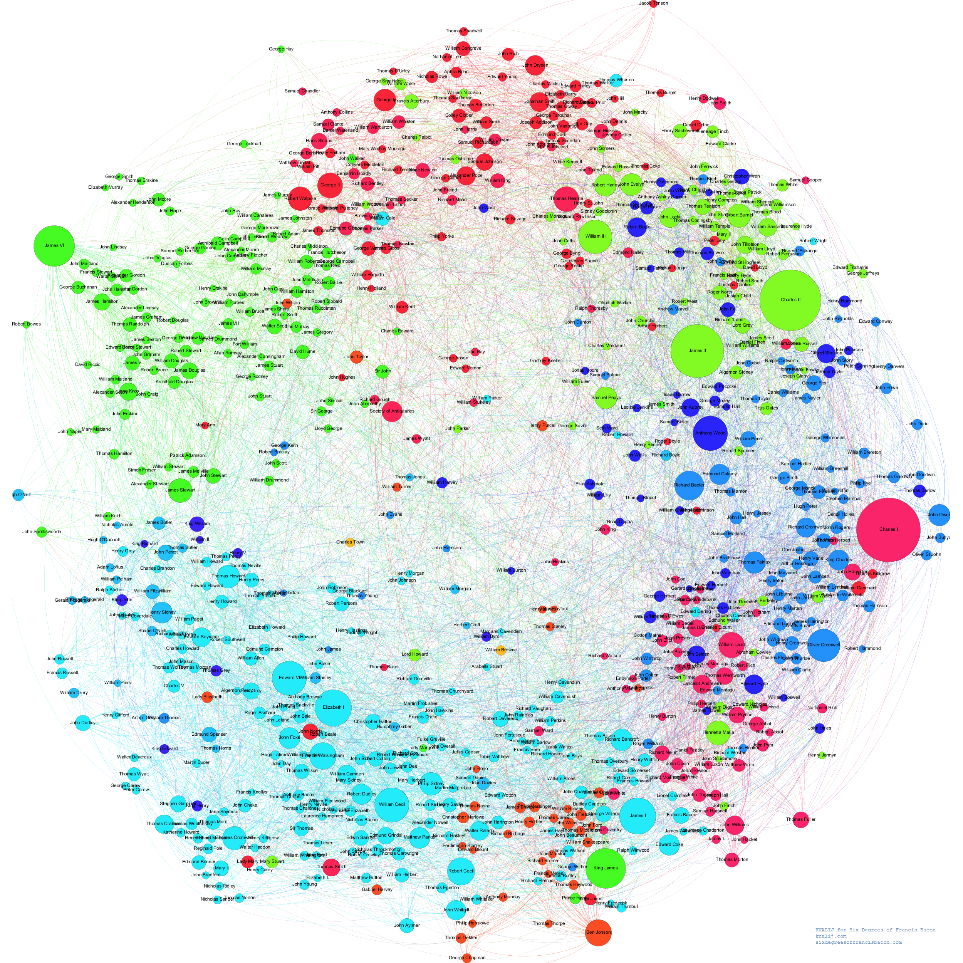
Subgraph Matching
Efficient
(in a few seconds?)
on Billion Node Graphs
like this one
Presenters
Tugba Kulahcioglu
Sachin Srivastava
Authors
Zhao Sun
Hongzhi Wang
Haixun Wang
Bin Shao
Jianzhong Li

Slide 2











Subgraph Matching
c
s
f
m
Match pair of friends who live in the same city and enjoy the same music.

Slide 3
Subgraph Matching Basic Decomposing Approach
c
s
c₁
c₂
s₁
v₁
f
m
c
m
s
m₁
m₃
f₁
f
m
f
f
m
m₅
m₆
m₂
m₄
c1, f1, m1
c1, f1, m2
m1, f1
m2, f1
m3, f1
m4, f1
s1, f1, m1
s1, f1, m5
s1 → f1, m1, m5
c1 → f1, m1, m2, m5
c2 → m3, m4, m6
v1 → f1, m1, m3, m6
f1 → m1, m2, m3, m4, c1, s1, v1
m1 → f1, s1, v1
m2 → f1, c1
m3 → f1, c2, v1
m4 → f1, c2
m5 → c1, s1
m6 → m3, v1
s1, f1, m1, c1
Notes:
labeling

Slide 4
Subgraph Matching Our Approach
c
s
c₁
c₂
s₁
v₁
f
m
c
m
s
m₁
m₃
f₁
f
m
f
s
f
m₅
m₆
m₂
m₄
c1, f1, m1
c1, f1, m2
m1, f1, s1
s1, f1
f → f1
m → m1, m2, m3, m4, m5, m6
c → c1, c2
s → s1
v → v1
s1, f1, m1, c1
Notes:
we will add the bounding information

Slide 5
Subgraph Matching Basic Approach – Joining Results
c
s
f
m
c₁
c₂
s₁
v₁
c
f
s
m₁
m₃
f
m
m
m
f₁
f
c1, f1, m1
c1, f1, m2
f1, m1
f1, m2
f1, m3
f1, m4
s1, f1, m1
s1, f1, m5
m₅
m₆
m₂
m₄
s1, f1, m1, c1
Notes:
labeling

Slide 6
Subgraph Matching Joining Results in Distributed Graphs
v
f
m
c₁
f₁
f
m
s
v₁
m₃
M1
M2
M1
M2
m₂
m₆
M3
M4
m₄
S₁
Cluster graph
Notes:
labeling

Slide 7
Subgraph Matching: other applications
Route finding (going from point A to point B)
Logistics
Authorization and access control
Investment management and finance
Network impact analysis

Slide 8
According to Forbes
Several of the largest dating sites in the world have shifted toward graph databases in the last nine months.
LinkedIn has a large team working on a proprietary graph database, which sits at the center of nearly every operation at LinkedIn.
Twitter depends on a graph database, and has released FlockDB, a graph database it created, as open source.
Neo Technology, the creator of Neo4j, the most popular graph database, now has more than 30 Global 2000 companies adopt its technology, including enterprise brands like Wal-Mart, eBay, Lufthansa, and Deutsche Telekom.
Teradata just released a new type of SQL called SQL-GR, intended to make the graph analytics easy for enterprise users.
According to a report by industry observer DB-Engines, “Graph DBMSs are gaining in popularity faster than any other database category,” growing 300 percent since January of last year.

Slide 9
Questions?

